Slide 1
.NET Memory Leak Problems & Solution
Nguyễn Thanh Tùng

Slide 2
Table of Contents
.NET Framework Memory Management
Stack & Heap
Garbage collection
.NET Memory Leak Problems
What is memory leak?
Symptoms of memory leak
.NET Memory Leak Solutions
Finding memory leak
Solving memory leak

Slide 3
.NET Framework Memory Management

Slide 4
Stack & Heap
Easy Scalability
Consistent High Performance
Grow cluster without application changes, without downtime with a single click
Consistent sub-millisecond read and write response times with consistent high throughput
Always On 24x365
Flexible Data Model
No downtime for software upgrades, hardware maintenance, etc.
JSON document model with no fixed schema.

Slide 5
Couchbase Server Architecture
8092
Query API
11211
Memcapable 1.0
11210
Memcapable 2.0
Moxi
Query Engine
Memcached
Couchbase EP Engine
Data Manager
Cluster Manager
REST management API/Web UI
Heartbeat
Process monitor
Node health monitor
Configuration manager
Rebalance orchestrator
Global singleton supervisor
vBucket state and replication manager
storage interface
New Persistence Layer
http
on each node
one per cluster
Erlang/OTP
HTTP
8091
Erlang port mapper
4369
Distributed Erlang
21100 - 21199

Slide 6
Couchbase Server Architecture
8092
Query API
11211
Memcapable 1.0
11210
Memcapable 2.0
RAM Cache, Indexing & Persistence Management
(C & V8)
Server/Cluster Management & Communication
(Erlang)
Moxi
Query Engine
Object-level Cache
Couchbase EP Engine
REST management API/Web UI
Heartbeat
Process monitor
Configuration manager
Node health monitor
Rebalance orchestrator
Global singleton supervisor
vBucket state and replication manager
storage interface
New Persistence Layer
Disk Persistence
http
on each node
one per cluster
Erlang/OTP
HTTP
8091
Erlang port mapper
4369
Distributed Erlang
21100 - 21199
Notes:
The network/cluster management is written in Erlang with several components:
- OTP : Open Telecom Platform
- all the administartion console is created in Erlang :
- REST API
- Web UI (many JS with JQuery and Sparkline)
- The data server is written in C
Includes memcache as main cache for the DB
The storage itself is also written in C, based on a Append only

Slide 7

Single node - Couchbase Write Operation
Doc 1
App Server
Couchbase Server Node
3
2
3
Managed Cache
To other node
Replication Queue
Doc 1
Doc 1
Disk Queue
Disk
Notes:
1. A set request comes in from the application .
2. Couchbase Server responses back that they key is written
3. Couchbase Server then Replicates the data out to memory in the other nodes
4. At the same time it is put the data into a write que to be persisted to disk

Slide 8
Single node - Couchbase Read Operation
GET Doc 1
App Server
Couchbase Server Node
3
2
3
Managed Cache
To other node
Replication Queue
Doc 1
Doc 1
Disk Queue
Disk
Doc 1
Notes:
1. A set request comes in from the application .
2. Couchbase Server responses back that they key is written
3. Couchbase Server then Replicates the data out to memory in the other nodes
4. At the same time it is put the data into a write que to be persisted to disk

Slide 9
Basic Operation
App Server 1
App Server 2
COUCHBASE Client Library
COUCHBASE Client Library
Cluster Map
Cluster Map
READ/WRITE/UPDATE
Docs distributed evenly across servers
Each server stores both active and replica docs
Only one server active at a time
Client library provides app with simple interface to database
Cluster map provides map to which server doc is on
App never needs to know
App reads, writes, updates docs
Multiple app servers can access same document at same time
Server 1
Server 2
Server 3
Active
Active
Active
Doc 5
Doc
Doc 4
Doc
Doc 1
Doc
Doc 2
Doc
Doc 7
Doc
Doc 2
Doc
Doc 9
Doc
Doc 8
Doc
Doc 6
Doc
REPLICA
REPLICA
REPLICA
Doc 4
Doc
Doc 6
Doc
Doc 7
Doc
Doc 1
Doc
Doc 3
Doc
Doc 9
Doc
Doc 8
Doc
Doc 2
Doc
Doc 5
Doc
Couchbase Server Cluster

Slide 10
Add Nodes to Cluster
App Server 1
App Server 2
COUCHBASE Client Library
COUCHBASE Client Library
Cluster Map
Cluster Map
Two servers added One-click operation
Docs automatically rebalanced across cluster
Even distribution of docs
Minimum doc movement
Cluster map updated
App database calls now distributed over larger number of servers
READ/WRITE/UPDATE
READ/WRITE/UPDATE
Server 1
Server 2
Server 3
Server 4
Server 5
Active
Active
Active
Active
Active
Doc 5
Doc
Doc 4
Doc
Doc 1
Doc
Doc 2
Doc
Doc 7
Doc
Doc 2
Doc
Doc 9
Doc
Doc 8
Doc
Doc 6
Doc
REPLICA
REPLICA
REPLICA
REPLICA
REPLICA
Doc 4
Doc
Doc 6
Doc
Doc 7
Doc
Doc 1
Doc
Doc 3
Doc
Doc 9
Doc
Doc 8
Doc
Doc 2
Doc
Doc 5
Doc
Couchbase Server Cluster
User Configured Replica Count = 1
Notes:
Talking Points:
You can choose to self host files - this is including jQuery in the scripts folder in Visual Studio.
Can also just include jQuery from a CDN - simply change the script reference to point to jQuery on the CDN
Can be faster loading and client browser may already have jQuery file cached
Be careful! If the CDN goes down your site may also go down.
Source version is human readable.
Always include the minified version for your production code.

Slide 11
Fail Over Node
App Server 1
App Server 2
COUCHBASE Client Library
COUCHBASE Client Library
Cluster Map
Cluster Map
App servers accessing docs
Requests to Server 3 fail
Cluster detects server failed
Promotes replicas of docs to active
Updates cluster map
Requests for docs now go to appropriate server
Typically rebalance would follow
Server 1
Server 2
Server 3
Server 4
Server 5
Active
Active
Active
Active
Active
Doc 5
Doc
Doc 4
Doc
Doc 1
Doc
Doc 9
Doc
Doc 6
Doc
Doc 2
Doc
Doc 7
Doc
Doc 2
Doc
Doc 8
Doc
Doc
Doc 1
Doc 3
REPLICA
REPLICA
REPLICA
REPLICA
REPLICA
Doc 4
Doc
Doc 6
Doc
Doc 7
Doc
Doc 5
Doc
Doc 8
Doc
Doc 1
Doc
Doc 3
Doc
Doc 9
Doc
Doc 2
Doc
Couchbase Server Cluster
User Configured Replica Count = 1

Slide 12
Couchbase Administration

Slide 13
Administration Tools
Web Administration Console
Configuring
Managing
Monitoring
Administration REST API
Using HTTP REST protocol
Can be called from your own custom management
Command Line Interface
Control Couchbase server & cluster installation
Functionality: Automated failover, backups…
Use REST API

Slide 14
Supported Platforms
Mixed deployments: cluster with both Linux and Windows server nodes are not supported.
Developer & Production:
Linux (Ubuntu, CentOS, RedHat…)
Windows 2008 R2 SP1 64bit
Developer only for:
Windows 2012
Windows 7, 8
MacOS

Slide 15
Resource Requirements
Quad-core: 64bit CPU with 3Ghz
Six-core if use XDCR and views
16GB RAM: 40% for OS -> 9.6GB RAM for Couchbase
Storage device: Hard disk, SSD, EBS, iSCSI (NFS is not supported)
1GB for application logging
At least 2x16GB RAM = 32GB for persistence of information

Slide 16
Upgrading Couchbase
Feature | Online Upgrades | Offline Upgrades
Applications Remain Available | Yes | No
Cluster Stays in Operation | Yes | No
Cluster must be Shutdown | No | Yes
Time Required | Requires Rebalance, Upgrade, Rebalance per Node | All nodes in Cluster Upgraded at Once

Slide 17

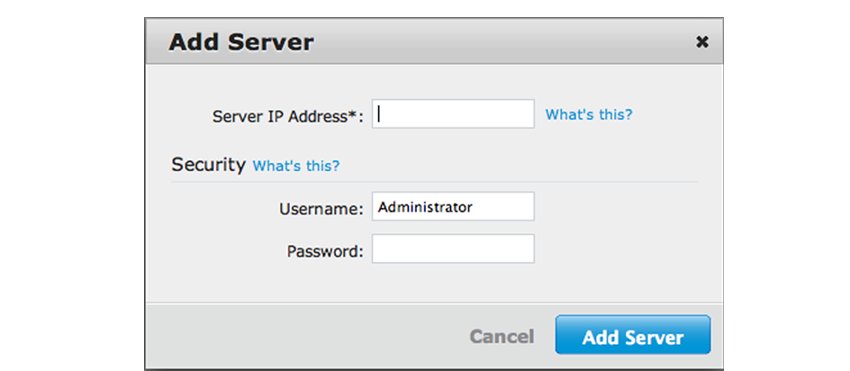
Upgrading Couchbase
Online Upgrade with Swap Rebalance
Backup your cluster
Add new server node
Remove old node
Rebalance
Repeat for all remaining old nodes

Slide 18
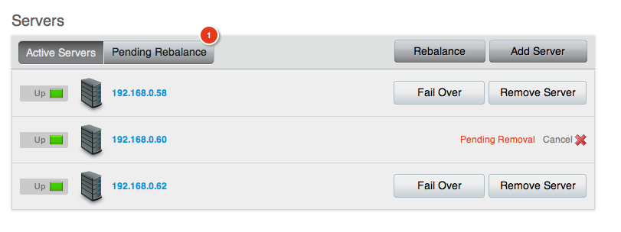
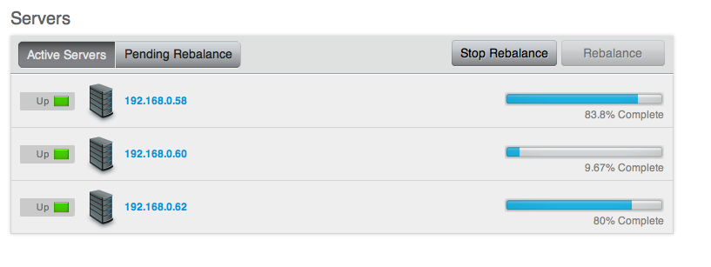
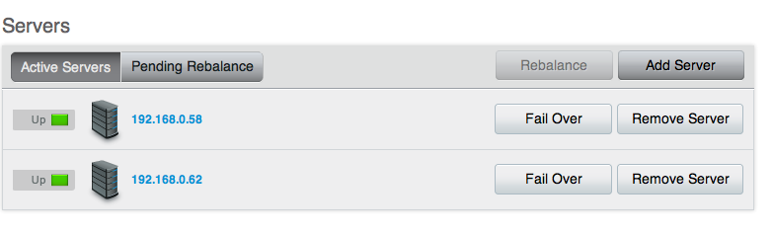
Upgrading Couchbase
Standard Online Upgrades
Backup your cluster
Remove node from cluster (recommend <=2 node at a time)
Rebalance
Upgrade removed node
Add back upgraded node to the cluster
Rebalance
Repeat for all remaining old nodes

Slide 19
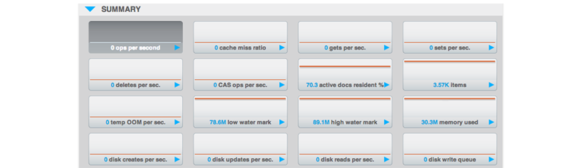
Upgrading Couchbase
Offline Upgrade Process
Disable Auto-Failover
Shutdown application
Backup cluster
Shutdown each node
Upgrade shutdown node
Switch on your application

Slide 20
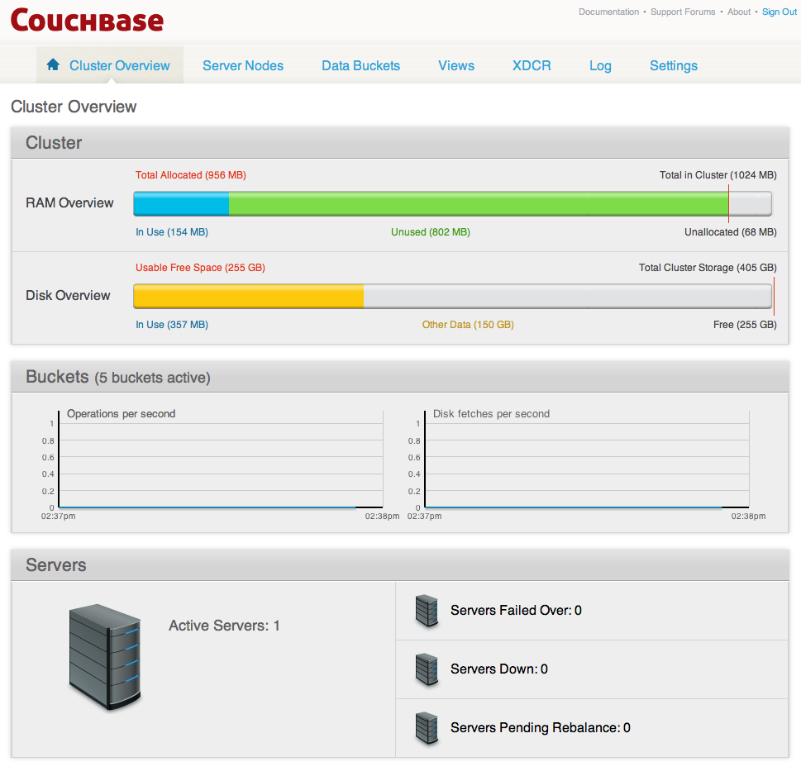
Web Console
Cluster Overview

Slide 21
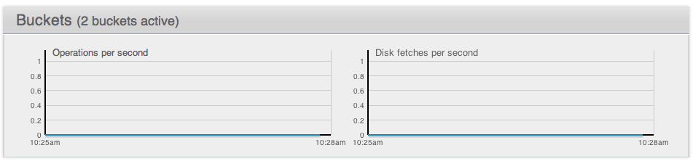
Cluster Overview
Buckets
Operations per second: activity on storing or retrieving objects from the data store.
Disk fetches per second: how frequently having to go to disk to retrieve information instead of using the information stored in RAM.

Slide 22
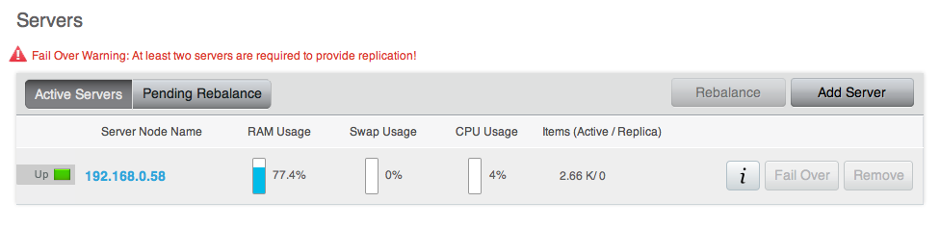
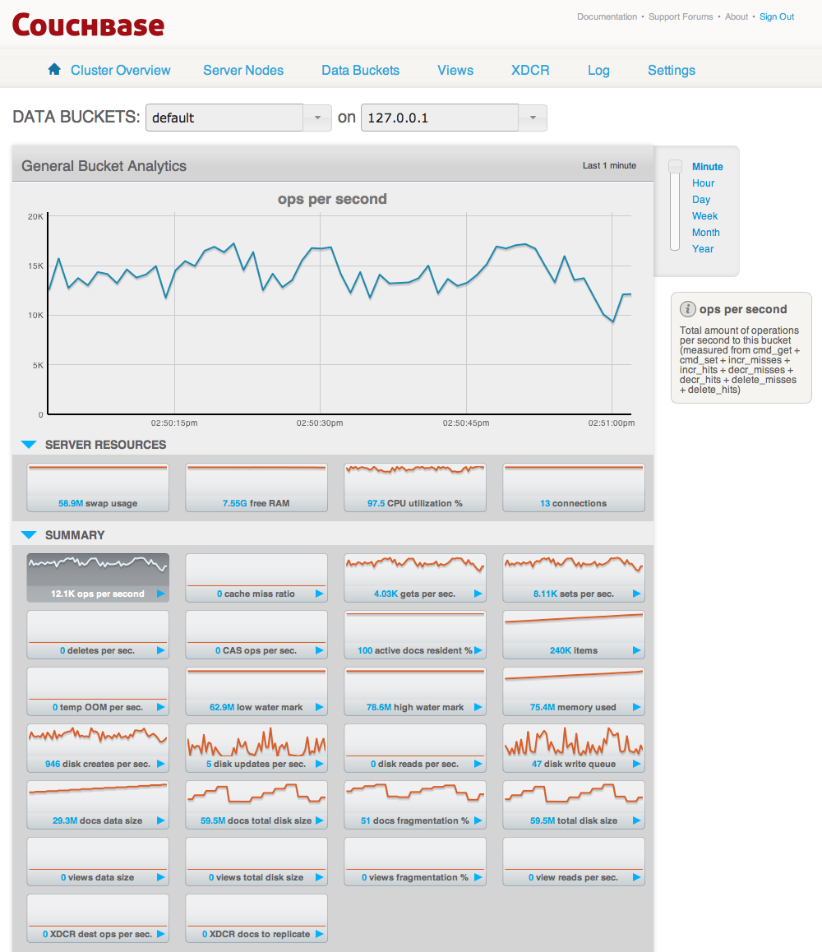
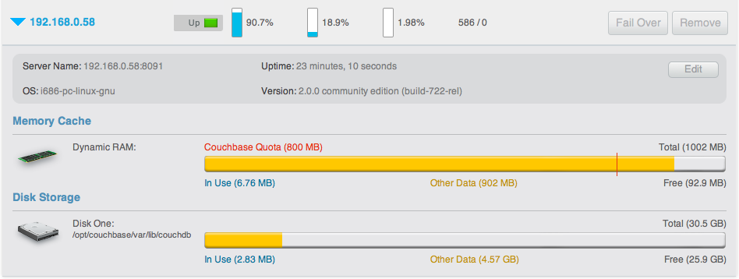
Server Nodes

Slide 23
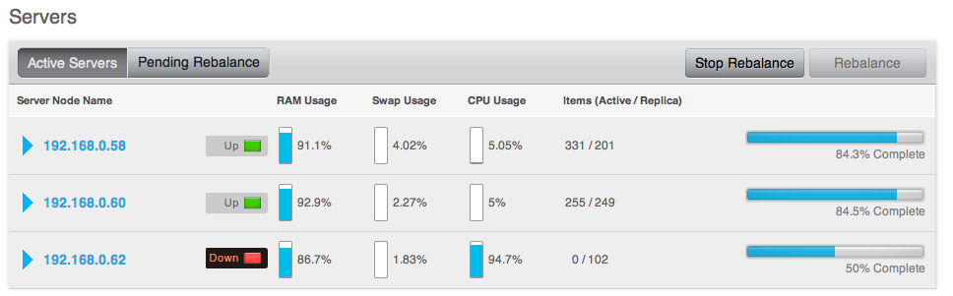
Server State
Up
Replicating data between nodes
Servicing requests from clients
Down
Not replicating data between nodes
Not servicing requests from clients
Pending
Up and currently filling RAM with data
Not servicing requests from clients

Slide 24
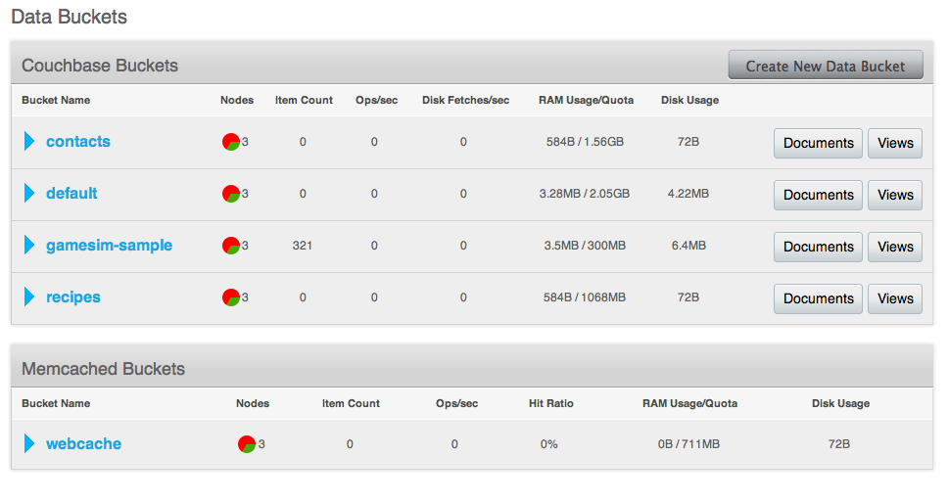
Data Bucket View

Slide 25
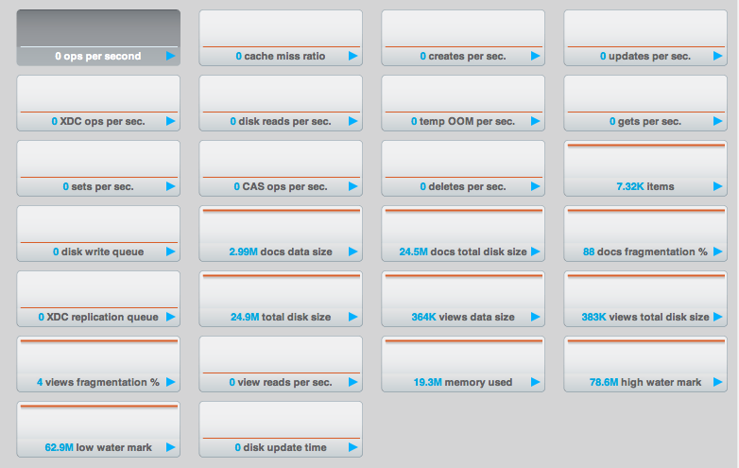
Bucket Monitoring — Summary Statistics
Cache miss ratio
Ratio of reads per second to this bucket which required a read from disk rather than RAM.
Temp OOM per sec
Number of temporary out of memory conditions per second.
Items
High water mark
Low water mark

Slide 26
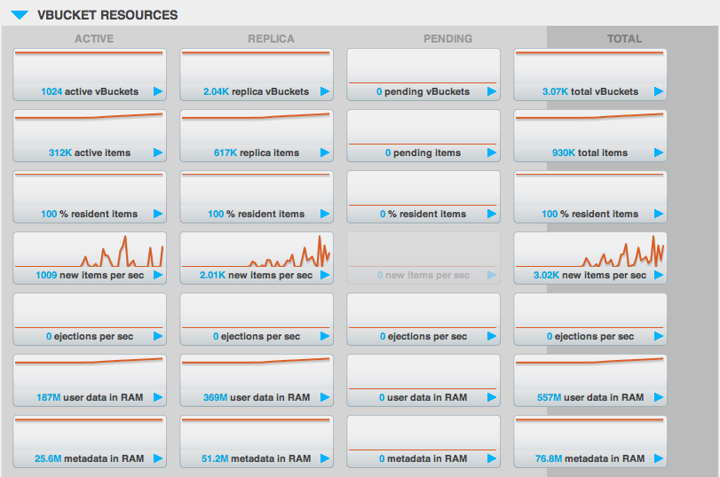
vBucket monitoring
Active
Replicate
Pending
Data is being exchanged during rebalancing

Slide 27
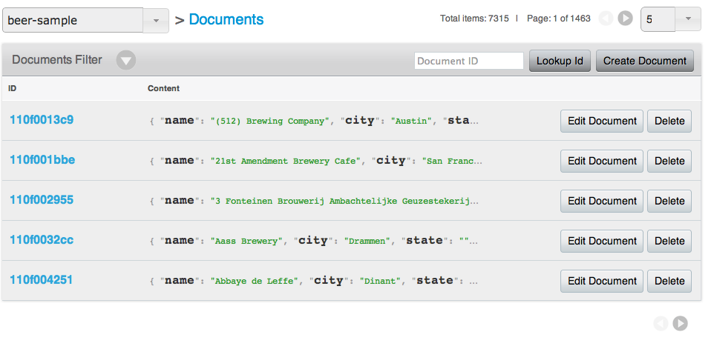
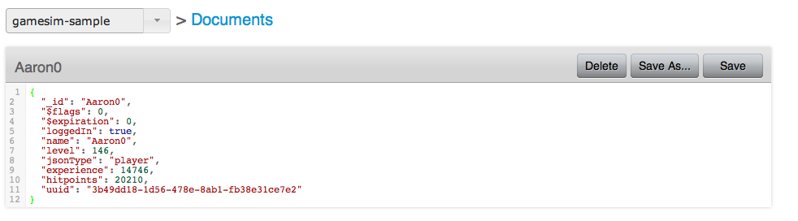
Document Editor

Slide 28
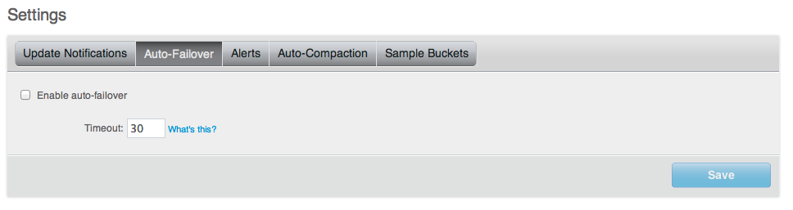
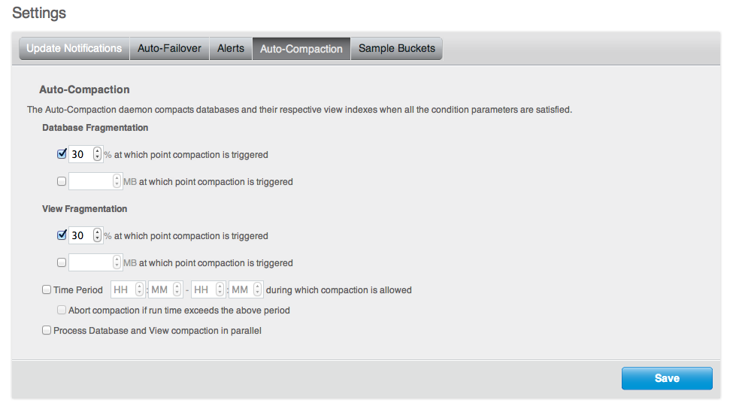
Settings
Enabling Auto-Failover
Enabling Auto-Compaction

Slide 29
Couchbase Querying

Slide 30
Views - Indexes
Indexing and querying data from your stored objects
Producing lists of data on specific object types
Producing tables and lists of information based on your stored data
Extracting or filtering information from the database
Calculating, summarizing or reducing the information on a collection of stored data

Slide 31
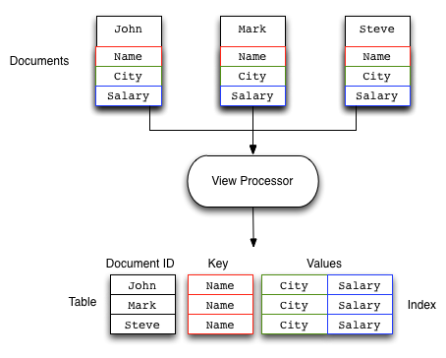
Views

Slide 32
Questions?

